Slide 1
GreatYields
a boutique investment house
Working Paper No. 6
Team A
Roy Madpis - Rawaa Makhoul - Alexandra Fatieieva

Slide 2
The Process
Data Preparation
Data Understanding
Removed features that decreased the model’s performance.
We created 7 new features.
New target variable - “realized_return_2%”
Evaluation & Deployment
8 excel files.
Locating “leakage” features.
Investigation and determination of the business significance
1
2
3
4
5
6
Considering Peer Lending
EDA
Modelling & Evaluation
Due to the low returns, Walter considered P2P Lending
Removing loans with:
“Term” higher than three years
A status that is not “Charged off” or “fully paid”
Removing features with many NAs
Splitting the data 70% - 30%.
Classification XGBoost Model.
Output: “Suggested Portfolio”

Slide 3
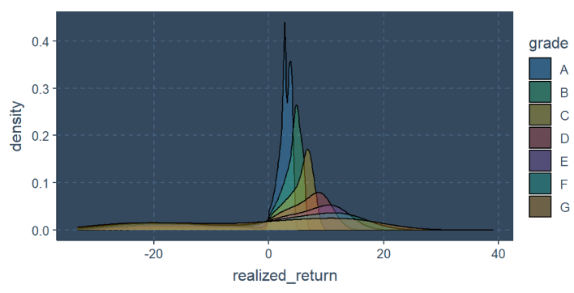
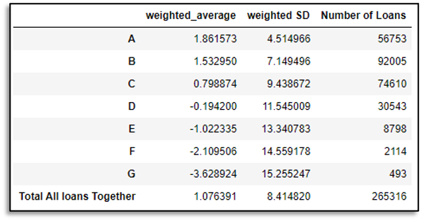



Question 1
What are the expected realized returns for the different loan grades?
How are the returns distributed for each grade?

Slide 4


Question 2
Is the available loan data informative, thus can help to select loans to invest in
(i.e., can the data help choose loans better than random selection, or selection by simple criteria (e.g., loan grade)?
We need criteria
Higher Realized Return
Lower Standard Deviation
Data is informative - if we are able to build a model that can generate one of the above.

Slide 5
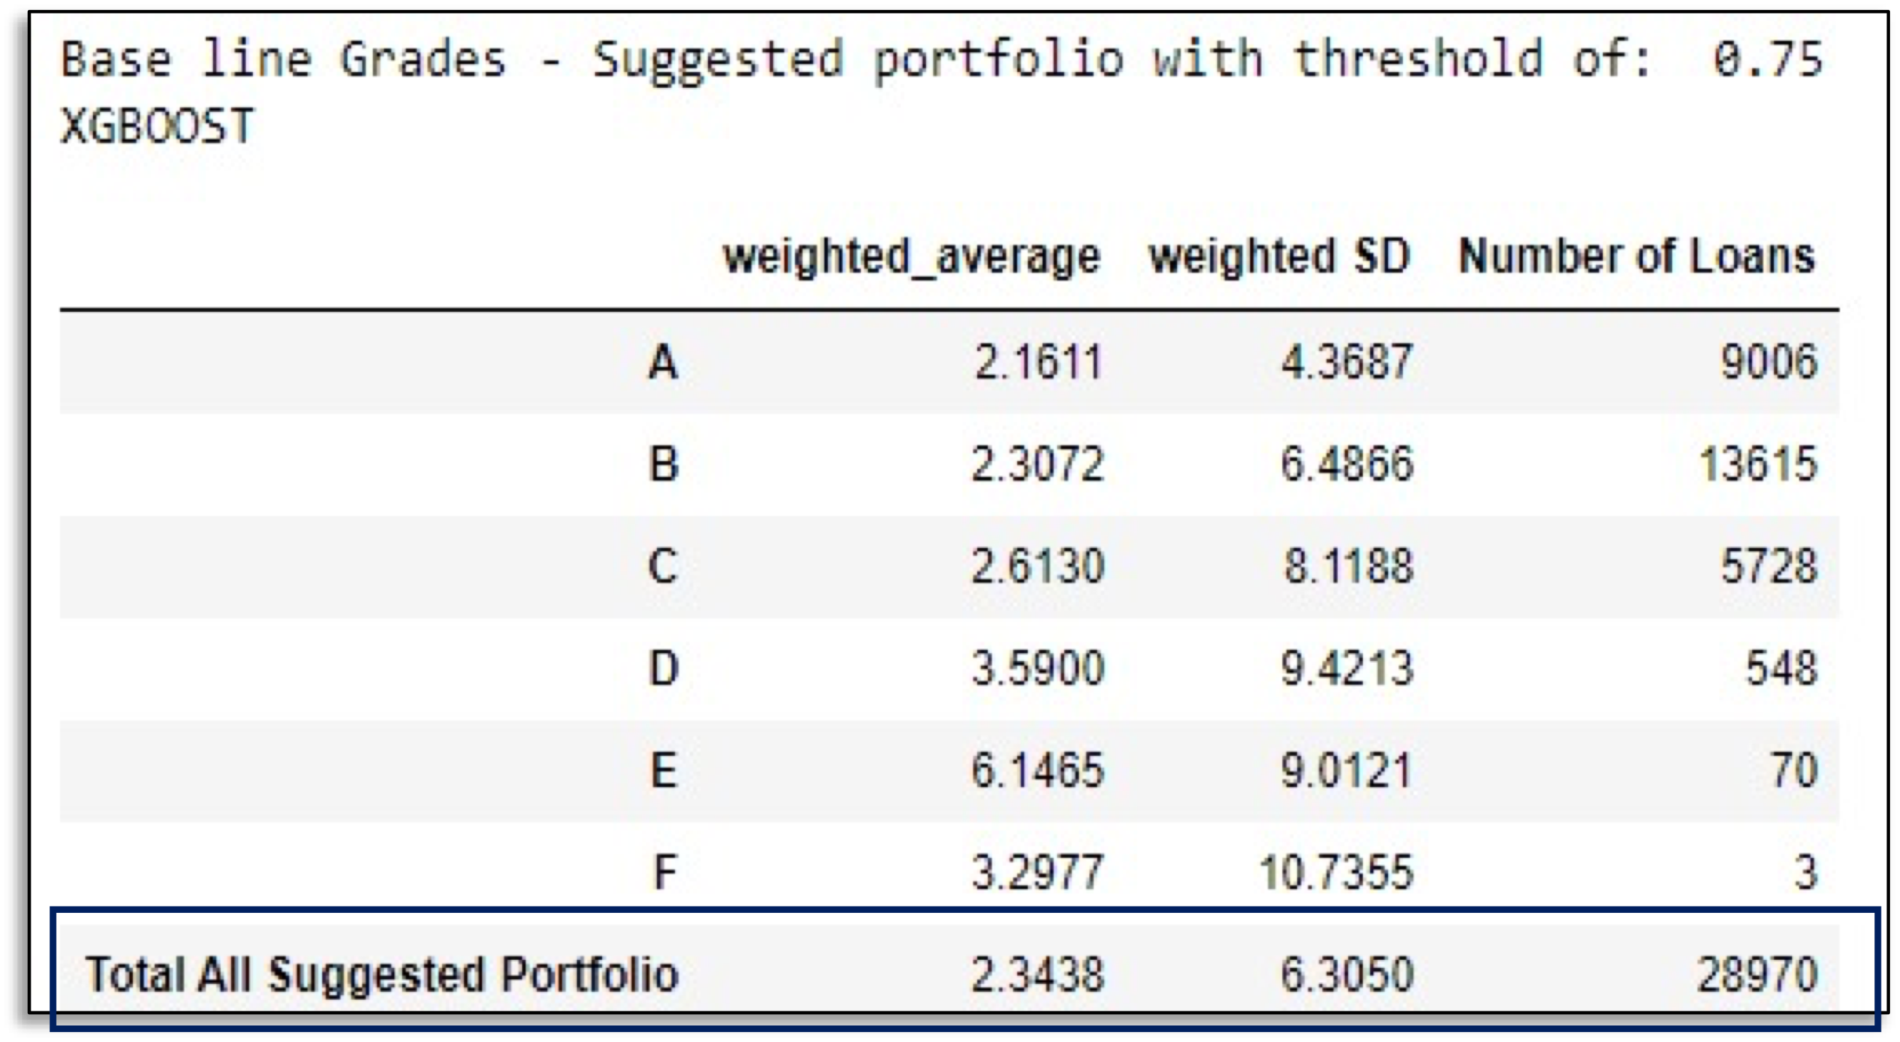
Question 2
Model Performance on Test Set

Slide 6
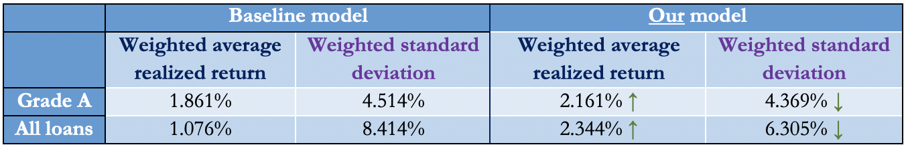

Question 2
Comparison between the baseline and our model
Data is indeed informative

Slide 7
Question 3
If the data is indeed informative, what increased performance can be expected, compared to a baseline of simply selecting loans based on their ratings (grades)?

Slide 8

Question 3
Increased Performance:
Basic approach
Two models approach

Slide 9
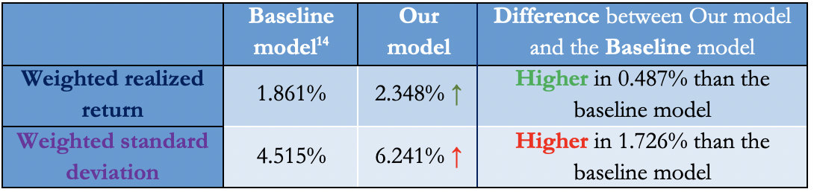
Question 3
Increased Performance:
Basic approach -
comparing our model with the best performance of the baseline model, investing only in loans with grade A

Slide 10

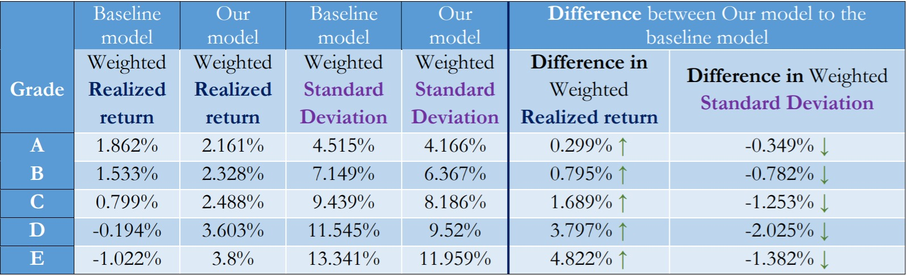

Question 3
Increased Performance:
Two models approach -
use our model with the grades model
We do not compare the F and G grades as there are only a few loans with the F grade and none of the loans in grade G entered the suggested portfolio

Slide 11
Question 4
What “average” returns can GreatYields expect from investing in peer lending loans? Keep in mind that ultimately, the goal is to maximize returns (i.e., make as much money as possible).
Average return ≈ 2.34%
Threshold tradeoff - we can generate higher realized return at the cost of less loans to invest in

Slide 12
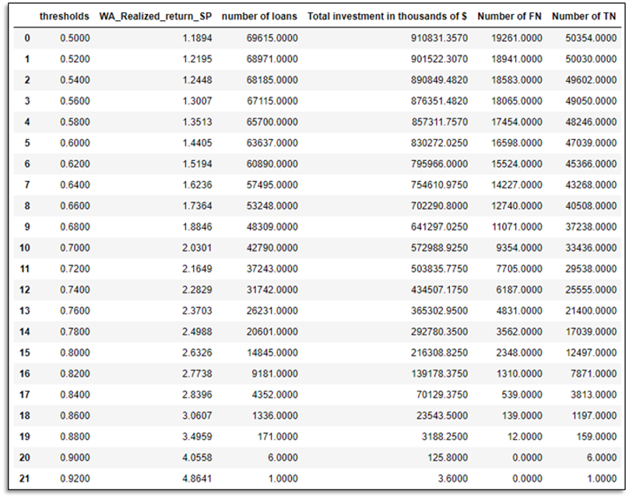
Question 4

Slide 13
Question 5
What is the risk level entailed in such investment (as measured by the volatility)?
We couldn’t calculate volatility, instead we decided to use the standard deviation of the realized return as a measure of a risk level
Weighted Standard Deviation ≈ 6.24%

Slide 14
Limitations
There are some important limitations one should consider when using our model.
Standard Deviation is relatively high (≈ 6.24%)
Small amount of loans
The model was trained on a portfolio with the following ratio of grades:
A very narrow suggested portfolio

Slide 15



Conclusions & Suggestions
Realized return higher / lower 2%.
Probability with specific threshold
we recommend threshold = 0.75
Suggested Portfolio
Realized return = 2.348% , Standard deviation = 6.241%
Final suggestion: to minimize the risk, invest only in grade A.
Weighted realized return = 2.161%, Weighted Standard deviation = 4.166%

Slide 16
Question?
Thank you

